Slide 1
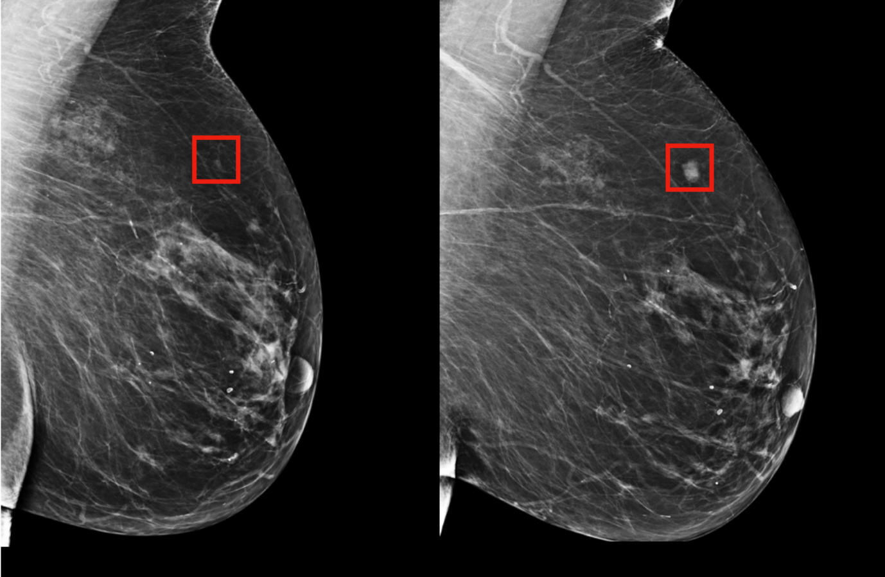
Detecting Breast Cancer with Data Mining Techniques
Team 11:
Meghna Bajoria [016661528],
Shakshi Richhariya[016043105], Vinit Kanani[016651323],
Kapil Wanaskar[016649880],
Reference

Slide 2

Shakshi

Slide 3
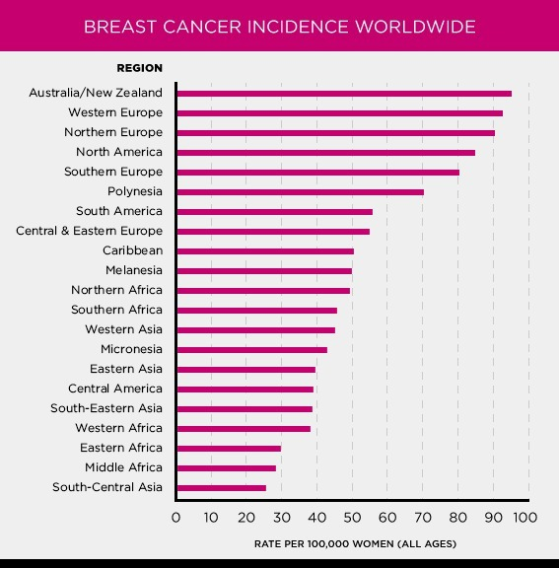
https://www.komen.org/breast-cancer/facts-statistics/breast-cancer-statistics/

Slide 4
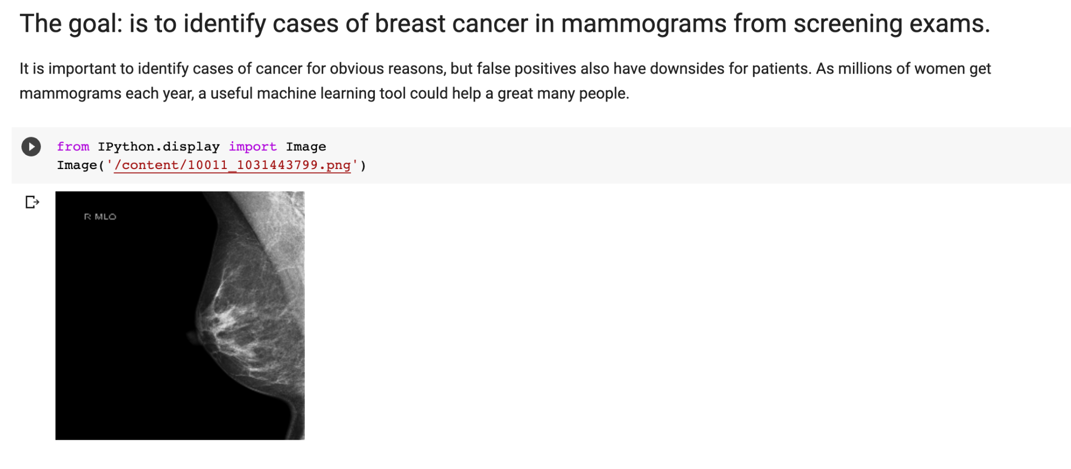

Slide 5
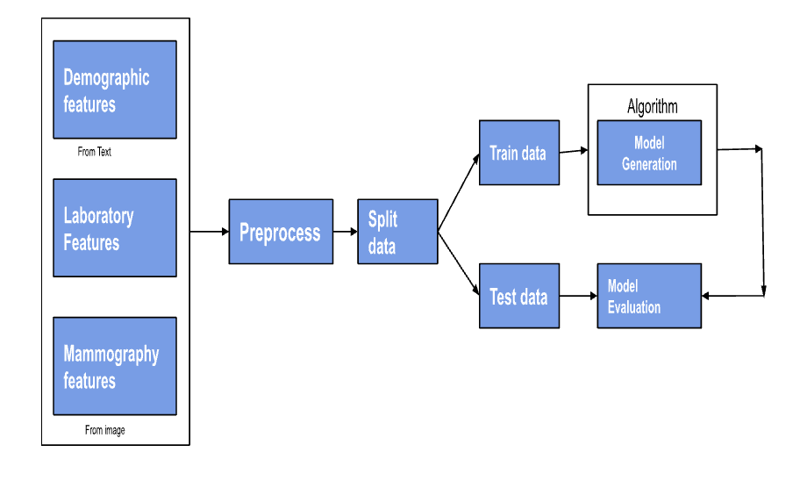
Flow Diagram from Data Extraction to Model Training and Testing

Slide 6
Flow
Data Extraction
EDA (Exploratory data analysis (EDA) )
Data pre processing (handling missing values, outliers, Normalization)
Model training and evaluation (metrics, such as accuracy, precision, recall, and F1-score)
Front-end and backend deployment

Slide 7
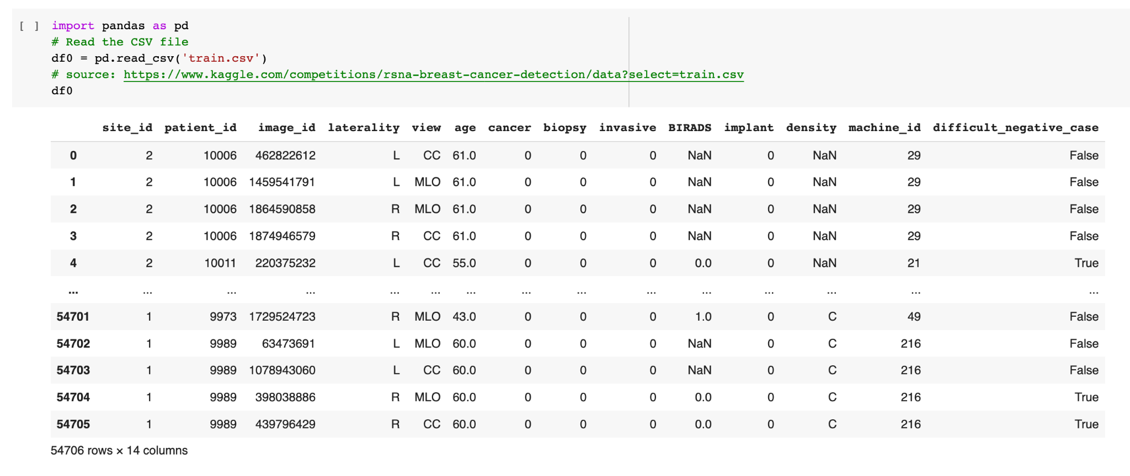

Slide 8
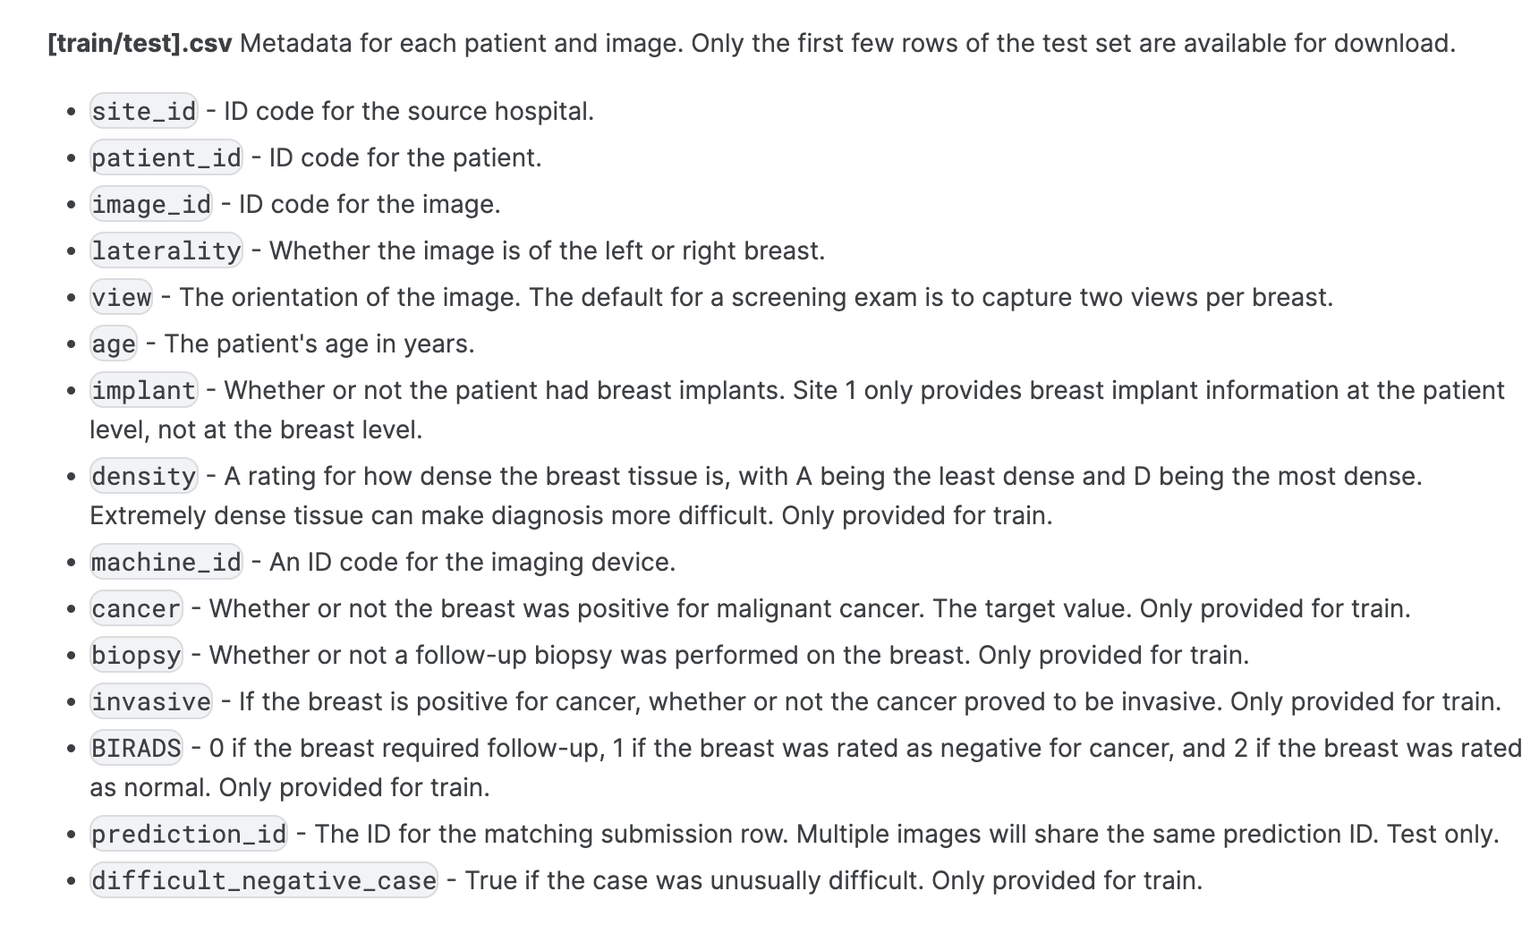

Slide 9
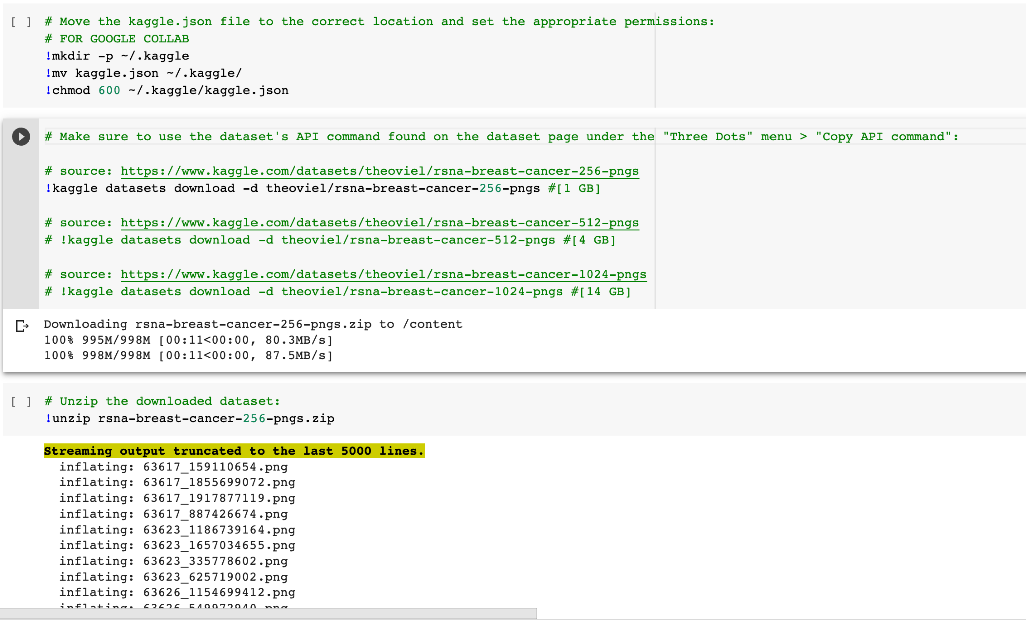

Slide 10
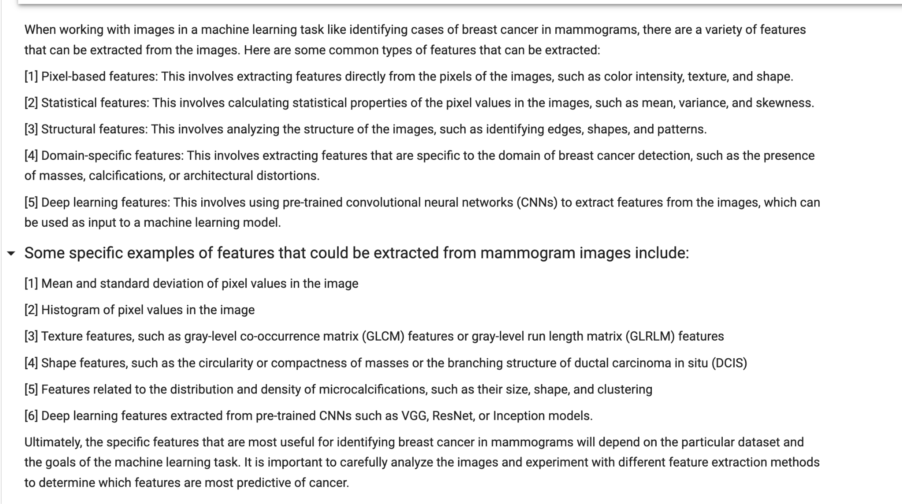

Slide 11

Kapil

Slide 13
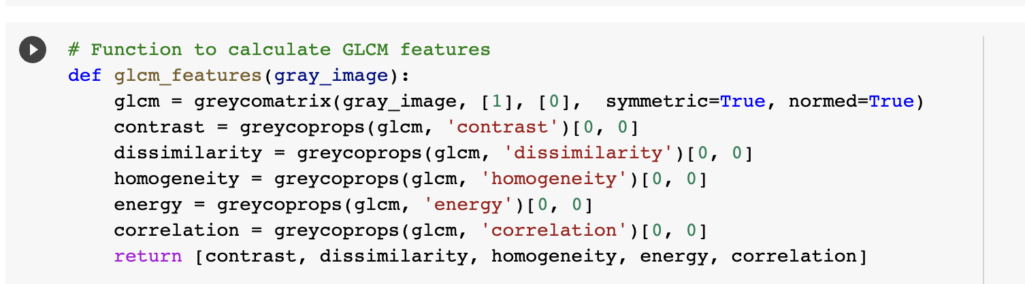
Creativity : Data Extraction from Images
Notes:
The provided code calculates texture features from a grayscale image based on its Gray Level Co-occurrence Matrix (GLCM).
The GLCM is a matrix that describes how often different combinations of pixel brightness values occur in an image.
Contrast: The code calculates the contrast by summing the squares of each pair of pixel intensity differences multiplied by their frequency of occurrence, based on the Gray Level Co-occurrence Matrix (GLCM).
Dissimilarity: The code computes dissimilarity as the sum of the absolute differences between each pair of pixel intensities, each weighted by their frequency in the GLCM.
Homogeneity: The code measures homogeneity by adding the GLCM values for each pixel pair, divided by 1 plus the square of their intensity difference.
Energy: The code computes energy (or Angular Second Moment) as the sum of squared GLCM elements, representing the textural uniformity of the image.
Correlation: The code determines correlation by assessing the pixel pairs' dependence on each other over the entire image, involving mean and standard deviation of the GLCM.

Slide 14
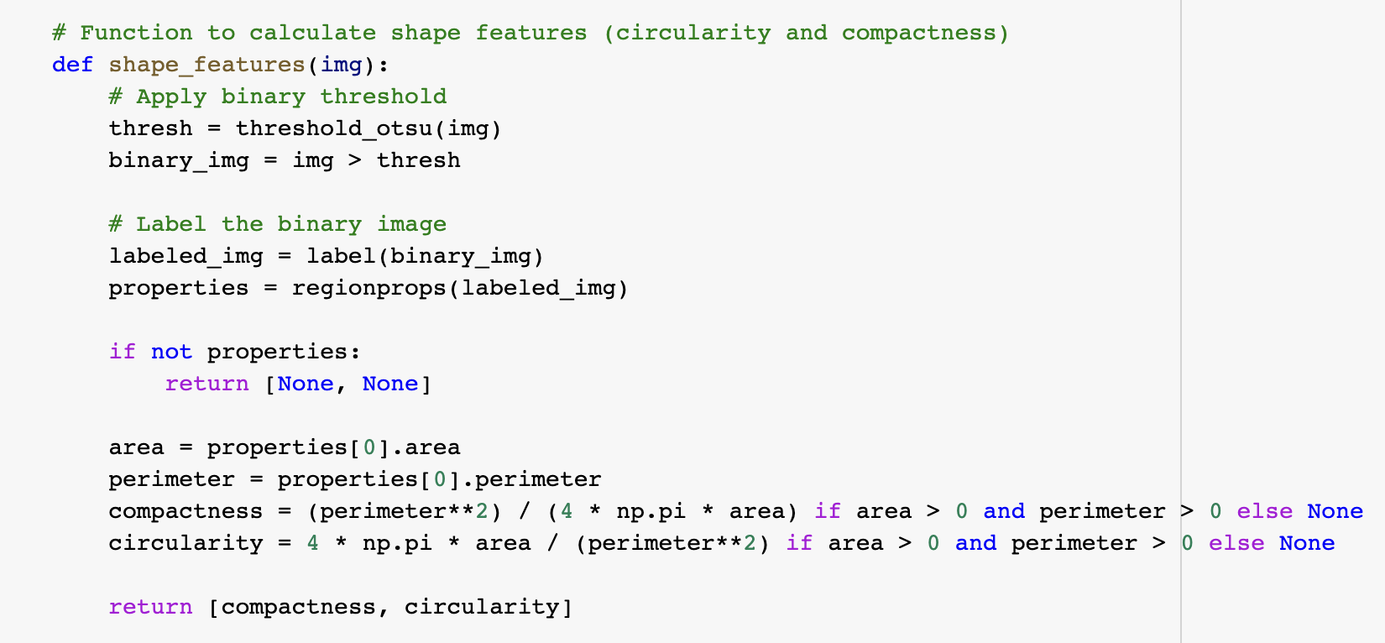
Creativity : Data Extraction from Images
Notes:
Thresholding: The code changes the image to black and white. It uses a method called Otsu's thresholding, which picks the best brightness level to separate objects from the background.
Labeling: After thresholding, the code identifies each separate object in the image, kind of like sticking a label on each one.
Area and Perimeter: For the first object found (or the biggest, in some versions), the code calculates the area (the total number of pixels inside the object) and the perimeter (the total number of pixels around the object's edge).
Compactness: The code uses the area and perimeter to calculate compactness. It's like comparing the object's perimeter to the perimeter of a perfect circle with the same area. The closer to 1, the more compact (circle-like) the object is.
Circularity: The code again uses the area and perimeter to calculate circularity. It's like comparing the object's area to the area of a perfect circle with the same perimeter. The closer to 1, the more circular the object is.

Slide 15
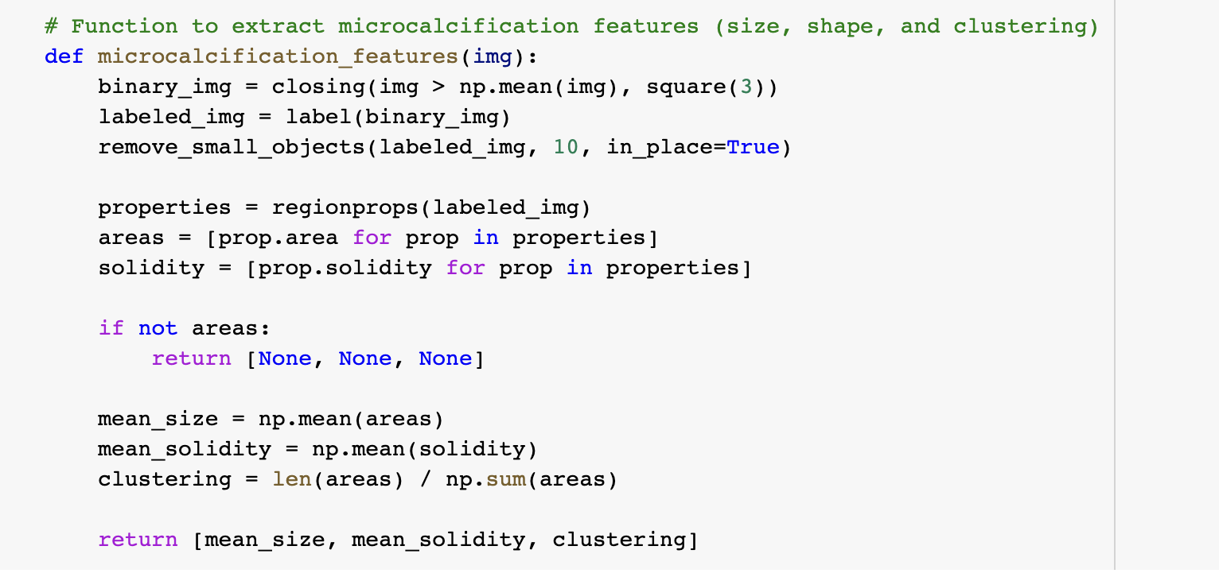
Creativity : Data Extraction from Images
Notes:
Processing: The code first processes the image to highlight small, bright objects (microcalcifications), and labels or identifies each separate object.
Size and Solidity: For each object, the code measures two things: its size (how many pixels are in it) and its solidity (how compact it is, or how much it fills its outer boundary).
Mean Size: The code then calculates the average size of all the objects found. It's like adding up all the sizes and then dividing by the number of objects.
Mean Solidity: It also calculates the average solidity. It's like adding up all the solidity scores and then dividing by the number of objects.
Clustering: Finally, the code calculates clustering. It's the number of objects divided by the total size of all objects. If objects are very small and numerous (more clustered), this number will be higher. If objects are large and few (less clustered), this number will be lower.

Slide 16
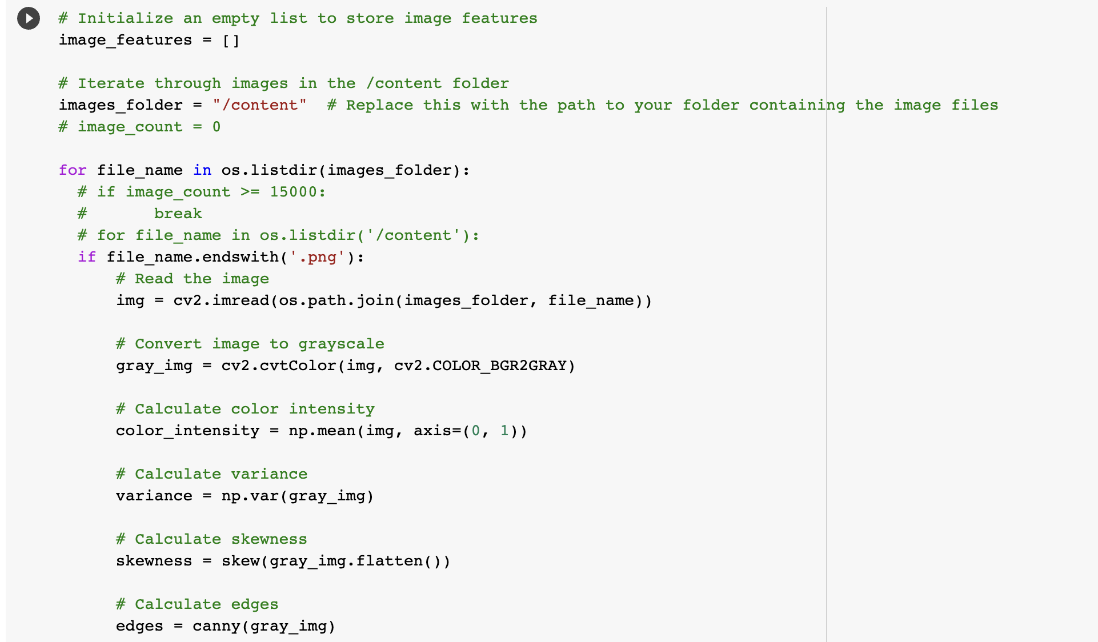
Creativity : Data Extraction from Images
Notes:
Color Intensity: The code computes the arithmetic mean of RGB channel intensities over the 2D pixel matrix, generating average coloration metrics per channel.
Basic Statistics: Statistical computations are performed over the flattened grayscale image matrix, generating metrics such as mean pixel intensity, standard deviation, variance, and skewness of the pixel intensity distribution.
GLCM Features: The script generates a Gray Level Co-occurrence Matrix (GLCM) encapsulating the spatial relationship between pixel intensities. Derived properties from GLCM like contrast, dissimilarity, homogeneity, ASM (energy), and correlation are computed.
Shape and Microcalcification Metrics: Binary thresholding and labeling identify discrete regions in the image. Morphological parameters like area and perimeter are leveraged to compute shape descriptors like circularity and compactness. Microcalcification features including mean size, solidity, and a measure of spatial density (clustering coefficient) are computed in a similar way.
Edge Count: Employing the Canny algorithm on the grayscale image matrix, edge detection is performed. The summation of detected edge pixels provides an overall count of edges present in the image.

Slide 17
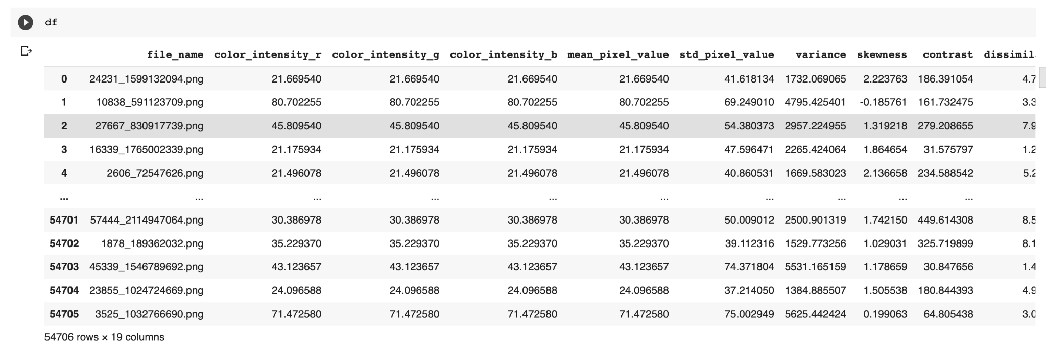
Creativity : Data Extraction from Images

Slide 19
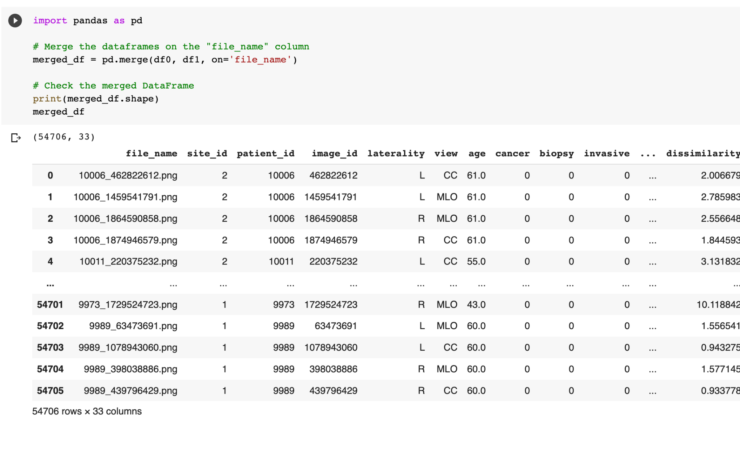

Slide 20
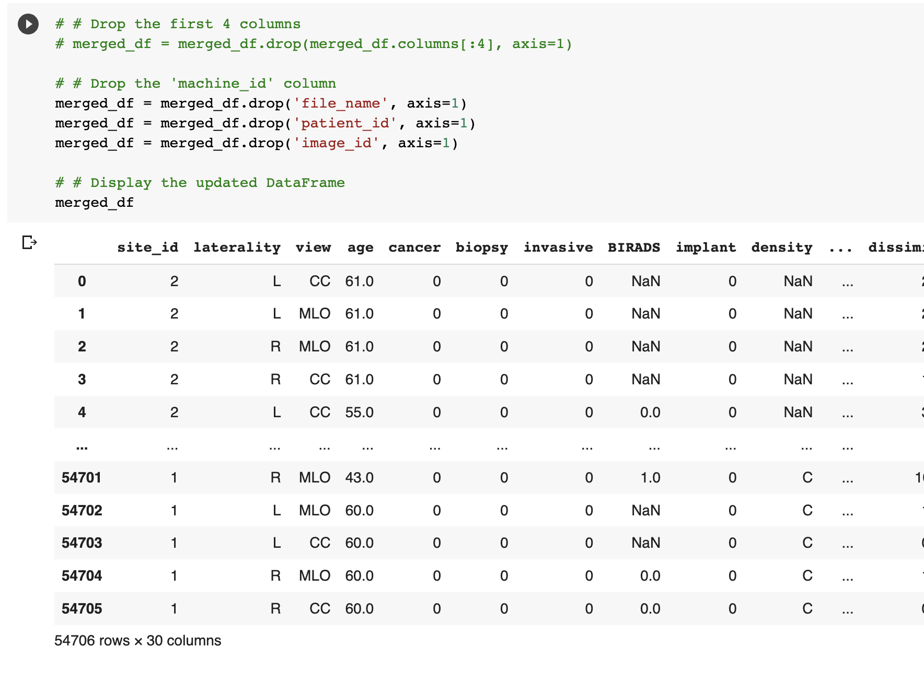

Slide 21
Shakshi

Slide 22
Exploratory Data Analysis
•EDA stands for exploratory data analysis, which is the process of analyzing and summarizing data sets to extract useful information and insights. While performing EDA, We came across several relationships between data but 2 of them were most promising.
1.There is a strong relationship between age and cancer. As people age, their risk of developing cancer increases. According to American cancer society[1] breast cancer mainly occurs in middle-aged and older women. The median age at the time of breast cancer diagnosis is 62. This finding is consistent with our findings in this dataset.
2.A biopsy is a medical procedure that involves the removal of a small sample of tissue or cells from the body for examination under a microscope. Therefore, cancer and biopsy both have strong correlation with each other.

Slide 23
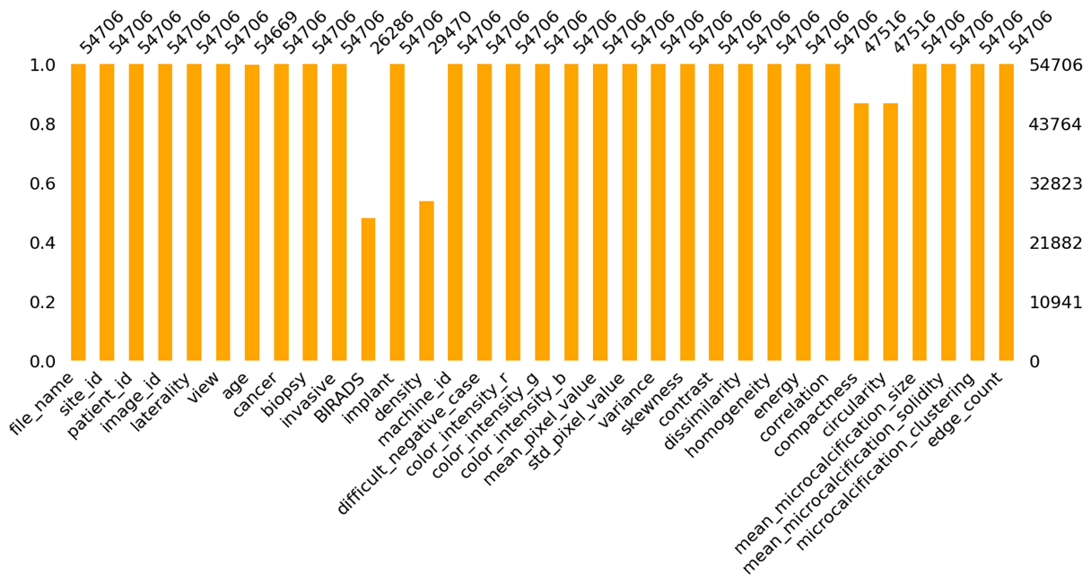
EDA
Missing values
There are multiple missing values in our dataset. All of these missing values are limited to 4 columns. It is really important to find missing values in our dataset because missing data can introduce bias and reduce the accuracy of our analysis.

Slide 24
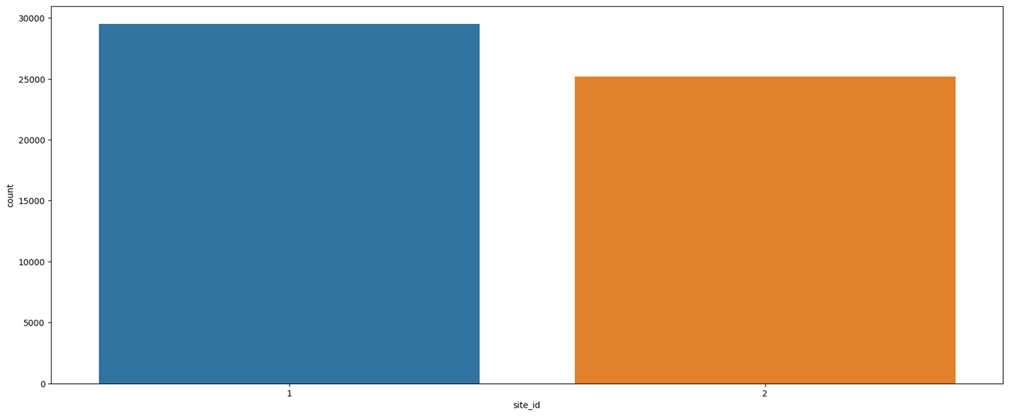
Site_id
The `site_id` attribute is important because it provides information about the source hospital that collected the data. This information can be useful in determining if there are any variations in the data collection process across different hospitals, which may affect the quality and reliability of the data. For example, certain hospitals may have different imaging devices, screening protocols, or biopsy practices that could potentially impact the accuracy of the breast cancer diagnosis. Understanding the source hospital can help researchers identify and control for any such differences, and potentially improve the quality of their analyses and predictions. Additionally, `site_id` can be useful for tracking the origin of the data, and for ensuring the privacy and security of patient information.

Slide 25
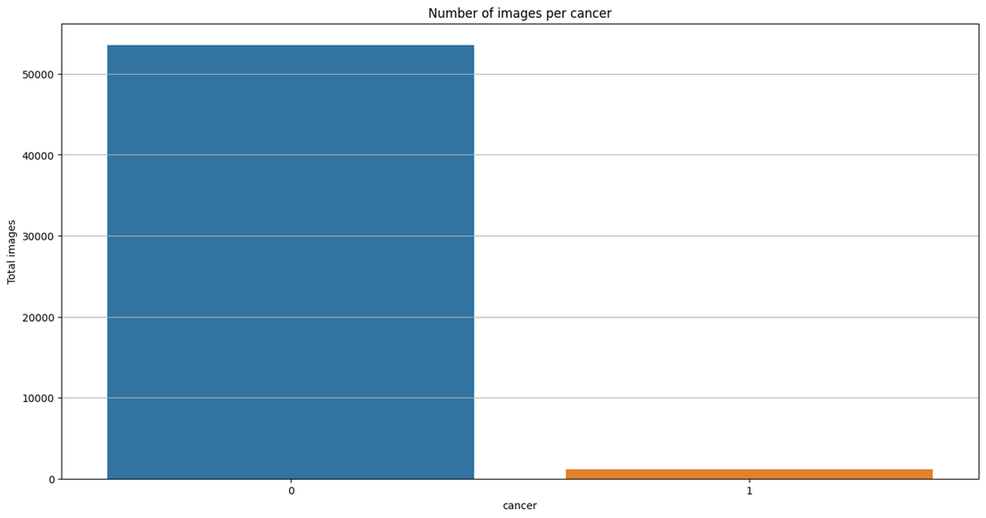
Number of cases for cancer
It was seen that most of the images correspond to Mammographies of non-cancer patients. This could be a challenge for the overall prediction as the percentage of cancer images is low.

Slide 26
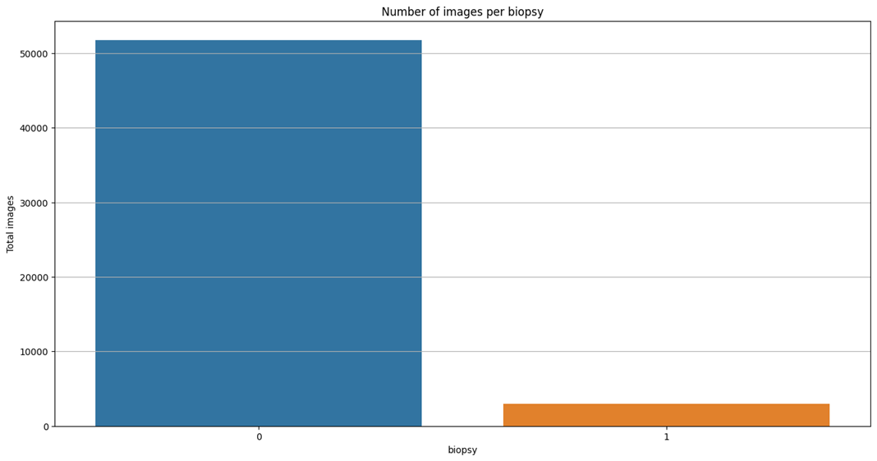
Biopsy
Biopsy also showed a similar trend where all the patients who underwent biopsy did not necessarily have cancer.

Slide 27
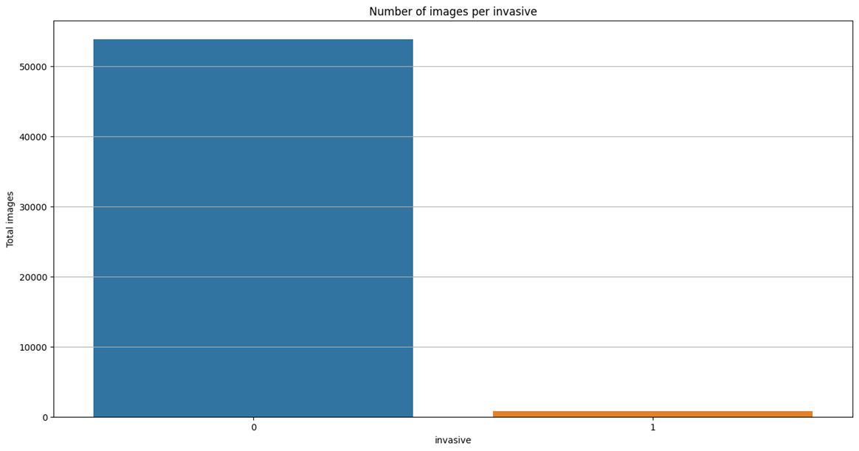
Number of cancer for invasiveness
It can be observed that not all the cancer images represent an invasive/harmful disease.

Slide 28

Meghna

Slide 29
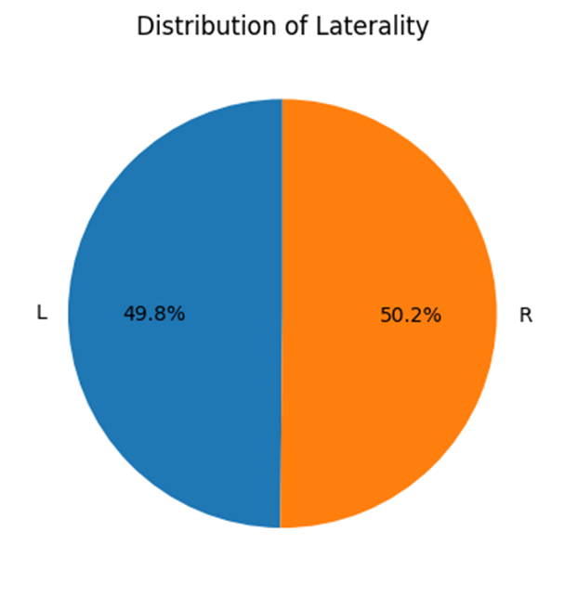
Distribution of laterality
The number of images for each laterality is almost equal for all the patients. This shows that screening Mammography is done on both breasts. This is a positive sign as it reduces the potential for biases or underrepresentation of either side. It also means that any differences or asymmetries in the prevalence or severity of breast cancer between the left and right sides can be more accurately assessed and analyzed.

Slide 30
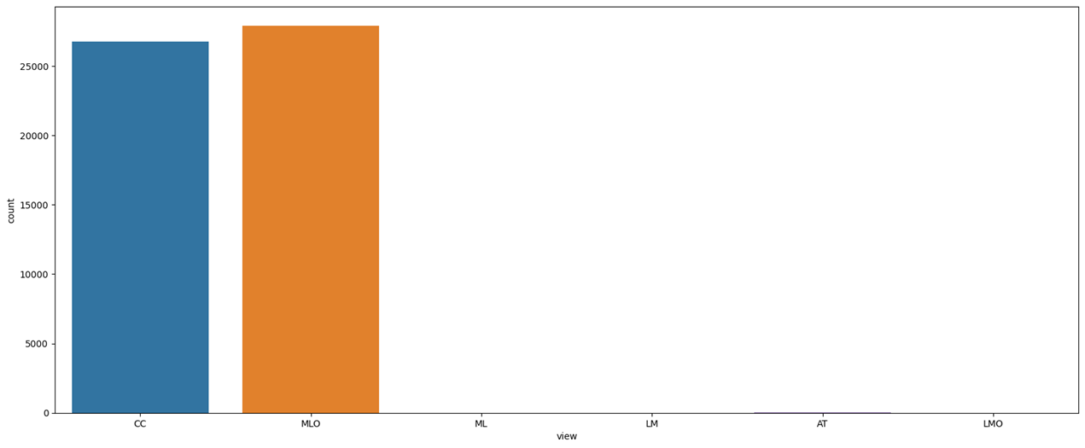
Images per view
Majority of data is taken in CC (cranial-caudal) or MLO (mediolateral oblique) view. This suggests that these two views are commonly used in breast imaging and are likely important for accurate diagnosis and assessment of breast health. The extremely low count of images taken in the AT (axial) view suggests that this view may not be commonly used in breast imaging or may not be as useful for assessing breast health as the CC and MLO views.

Slide 31
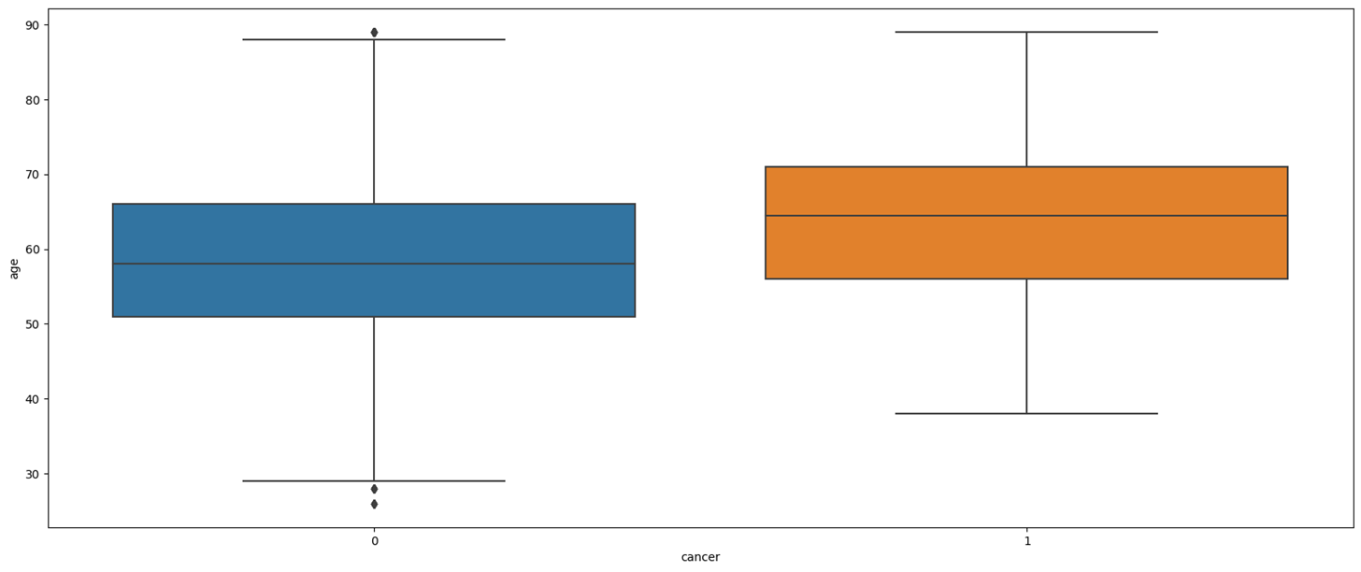
Outliers for age
We notice few outliers specifically the patients that are below the age of 30 and near 90 years of age.

Slide 32
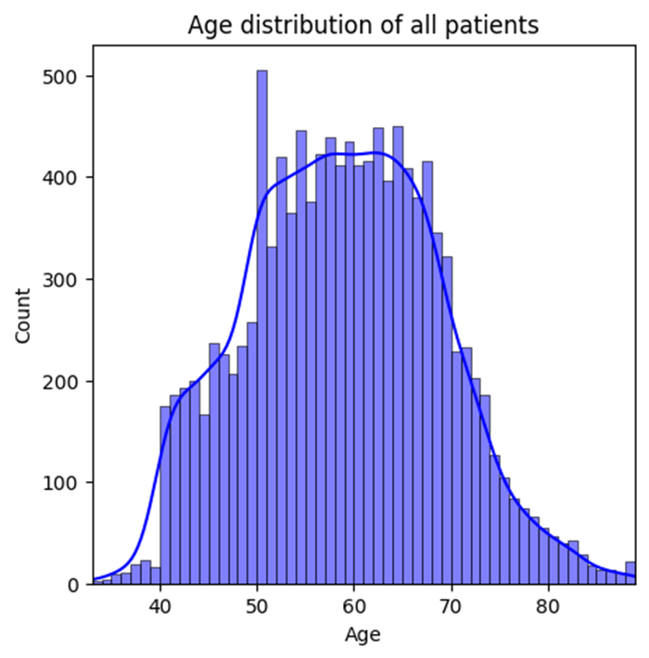
Age distribution of all patients
We notice a normal distribution. A normal distribution of age for all patients suggests that the ages of the patients in the dataset are evenly distributed around a central value, with relatively few patients at the extremes of the age range.

Slide 33
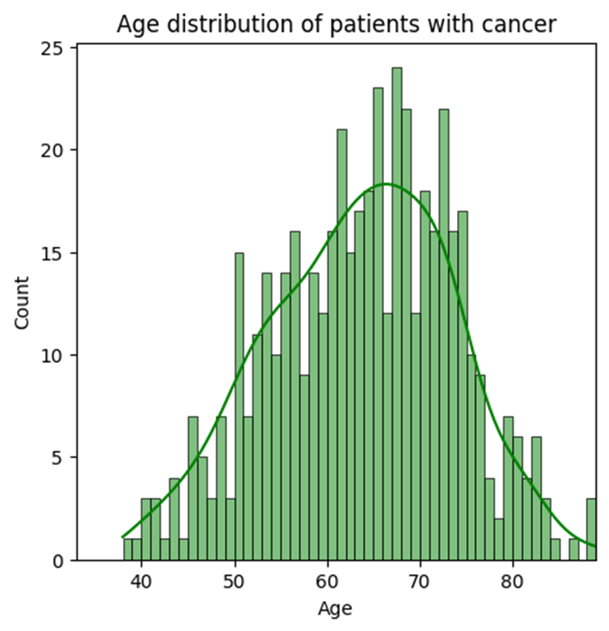
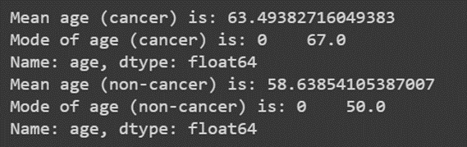
Age distribution of all patients with cancer
We can observe that the age of patients with cancer is negatively skewed. This means that most of the patients who had cancer were near the age of 60.

Slide 34
According to the most recent statistical data from National Cancer Institute Surveillance, Epidemiology, and End Results (SEER) Program, the median age of a cancer diagnosis is 66 years. This means that half of cancer cases occur in people below this age and half in people above this age. A similar pattern is seen for many common cancer types. For example, the median age at diagnosis is 62 years for breast cancer, 67 years for colorectal cancer, 71 years for lung cancer, and 66 years for prostate cancer.

Slide 35
•The mean and mode age of patients with cancer and without cancer in the dataset can provide insights into the typical age range of patients with and without cancer.
•The mean age of patients with cancer is 63.49 years, while the mean age of patients without cancer is 58.64 years. This suggests that patients with cancer tend to be older than those without cancer.
•The mode age of patients with cancer is 67 years, while the mode age of patients without cancer is 50 years. The mode represents the most common value in the dataset, so this indicates that the most common age for patients with cancer is 67 years, while the most common age for patients without cancer is 50 years.
•These findings are in line with what is known about breast cancer incidence, which increases with age, with the majority of cases diagnosed in women over 50 years old. Therefore, it is important to take age into account when analyzing breast cancer data and developing machine learning models to ensure that the models accurately reflect the age distribution of the real-world population.
•So we can conclude that age is an important factor for cancer.

Slide 36
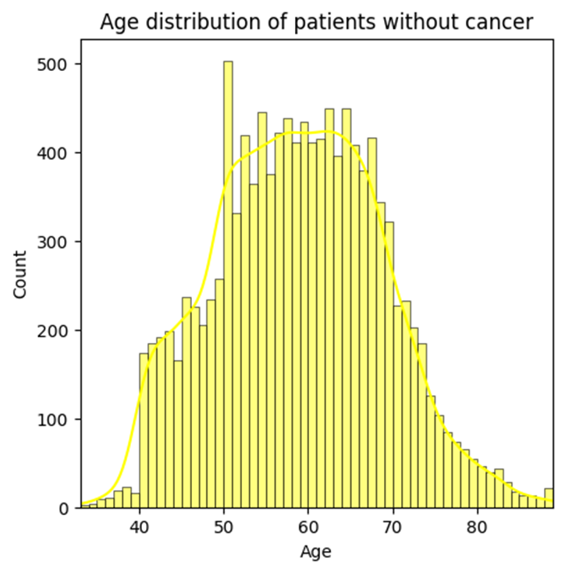
Age distribution of all patients without cancer
Age distribution of patients without cancer follows a normal distribution

Slide 37
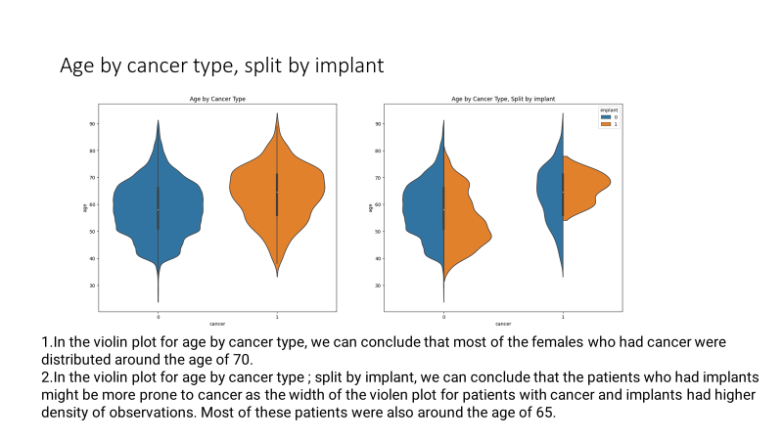

Slide 38
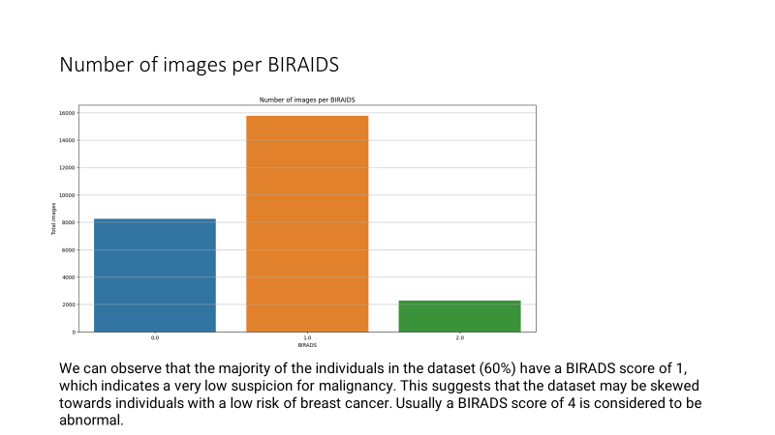

Slide 39
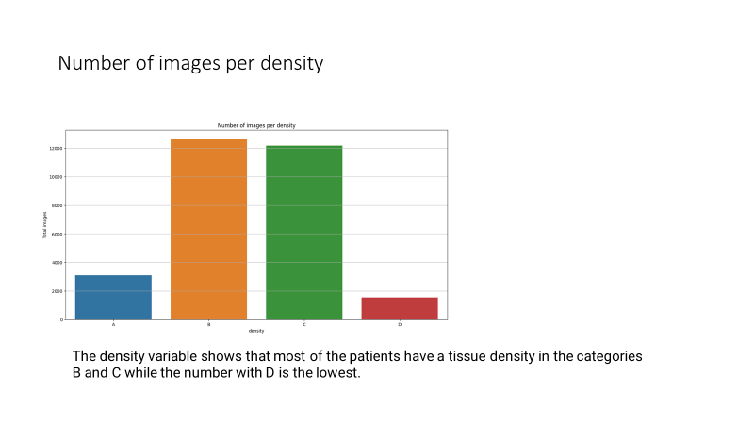

Slide 40
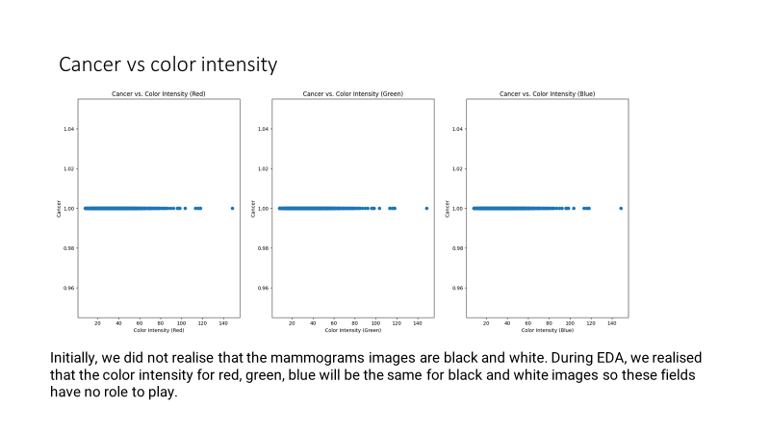

Slide 41
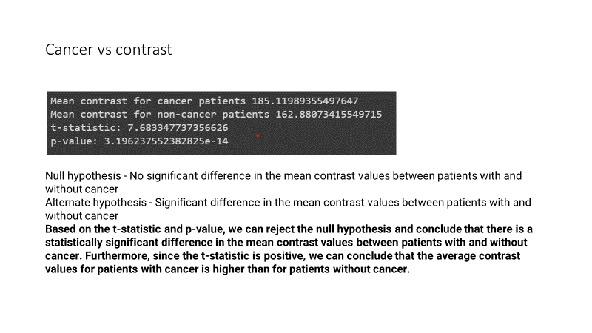

Slide 42
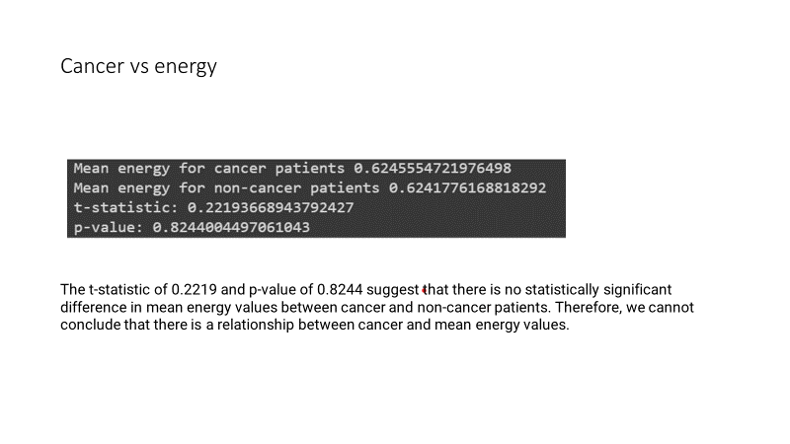

Slide 43
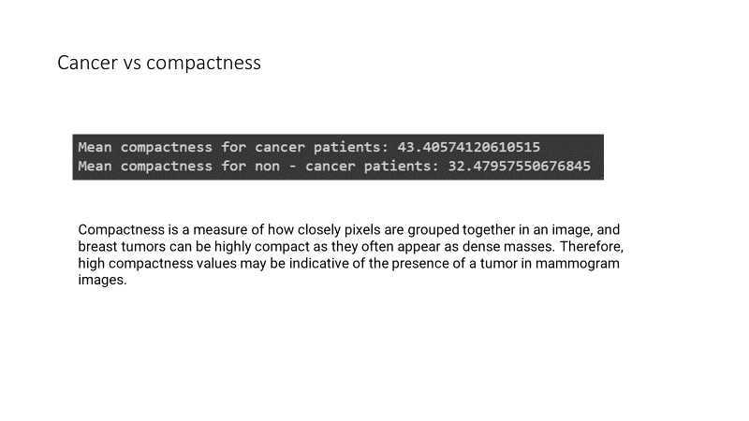

Slide 44
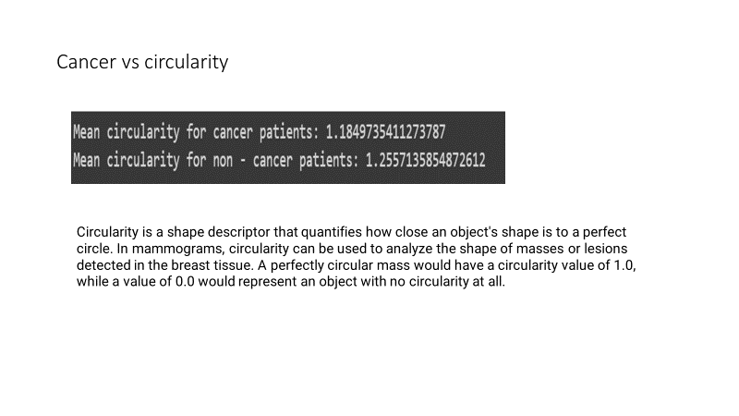

Slide 45
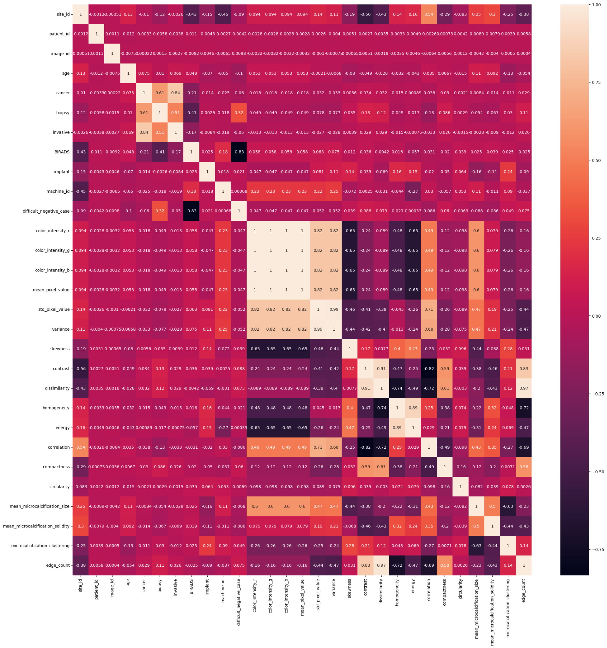

Slide 46
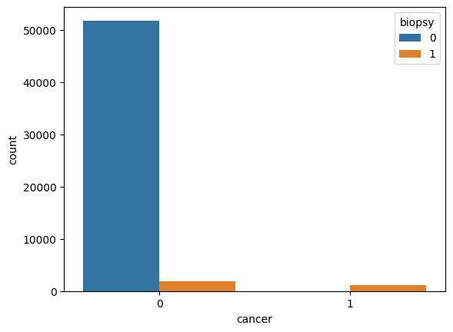
Cancer vs biopsy
We can see that biopsy does have a strong correlation to cancer. If cancer is not present, biopsy has also shown the same output for most of the data. And when cancer is presnt, we can see that biopsy has also returned the same value.

Slide 47
Conclusion for EDA
There is a strong relationship between age and cancer. As people age, their risk of developing cancer increases. According to American cancer society breast cancer mainly occurs in middle-aged and older women. The median age at the time of breast cancer diagnosis is 62. This finding is consistent with our findings in this dataset.
A biopsy is a medical procedure that involves the removal of a small sample of tissue or cells from the body for examination under a microscope. Biopsies are often used to diagnose cancer, as they can provide information about the presence of cancerous cells and their characteristics. The relationship between cancer and biopsy is therefore very important. A biopsy is typically recommended when cancer is suspected based on symptoms or imaging tests, such as X-rays, CT scans, or MRIs. By examining the biopsy sample, doctors can confirm the presence of cancer, determine its type and stage, and develop an appropriate treatment plan.

Slide 48
Kapil

Slide 49
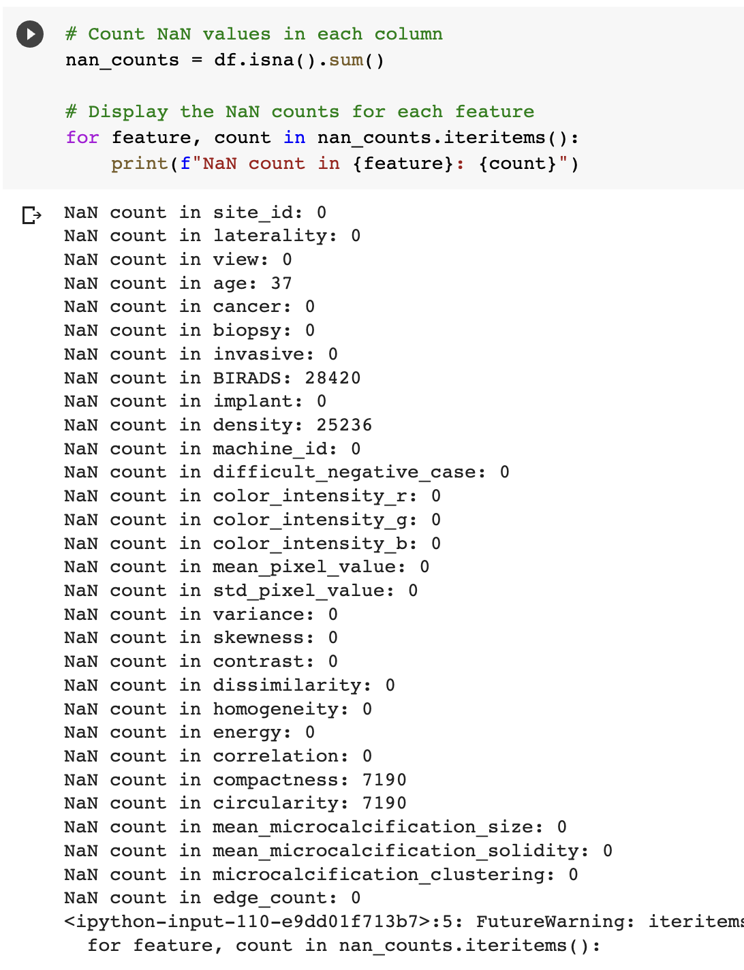
Remove – Nan values

Slide 50
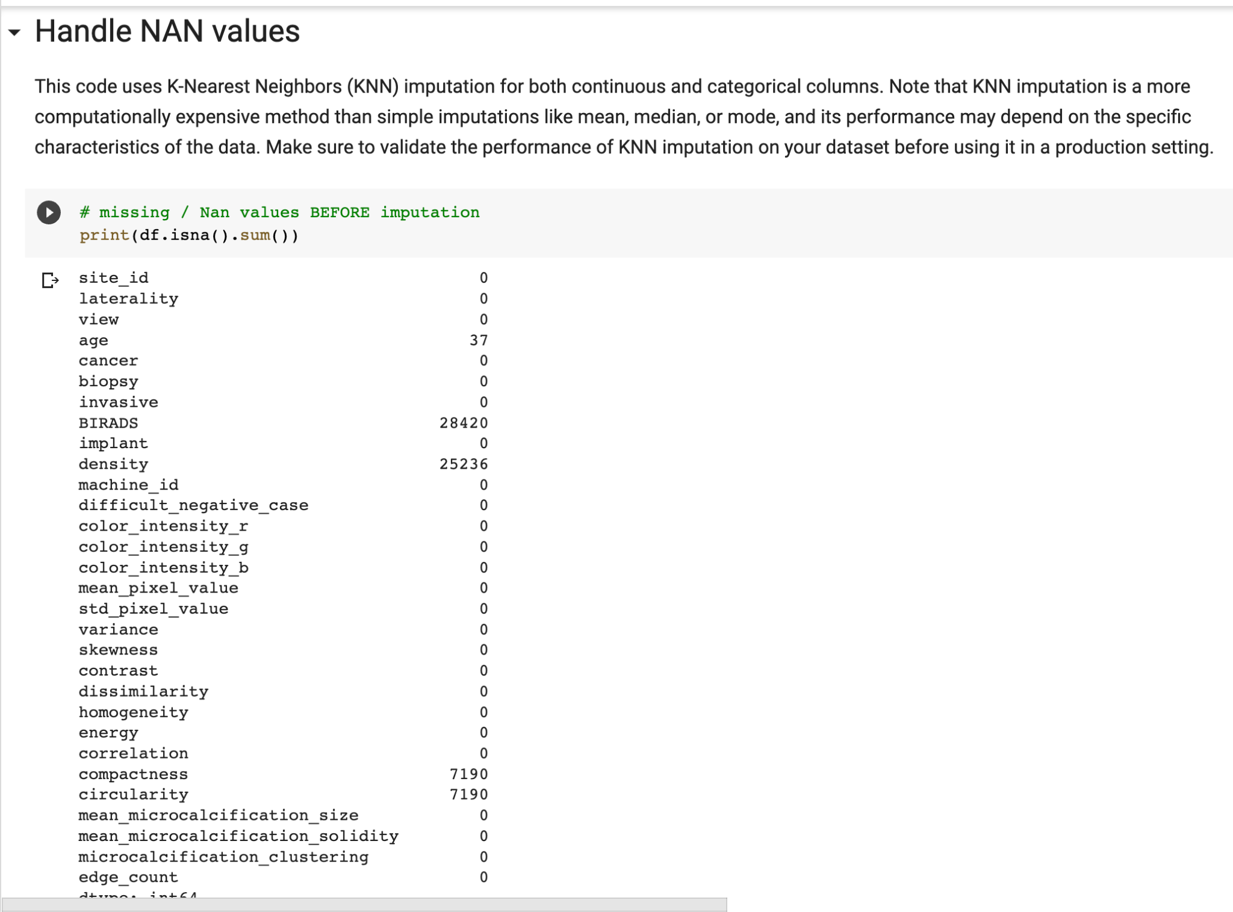
Remove – Nan values

Slide 51
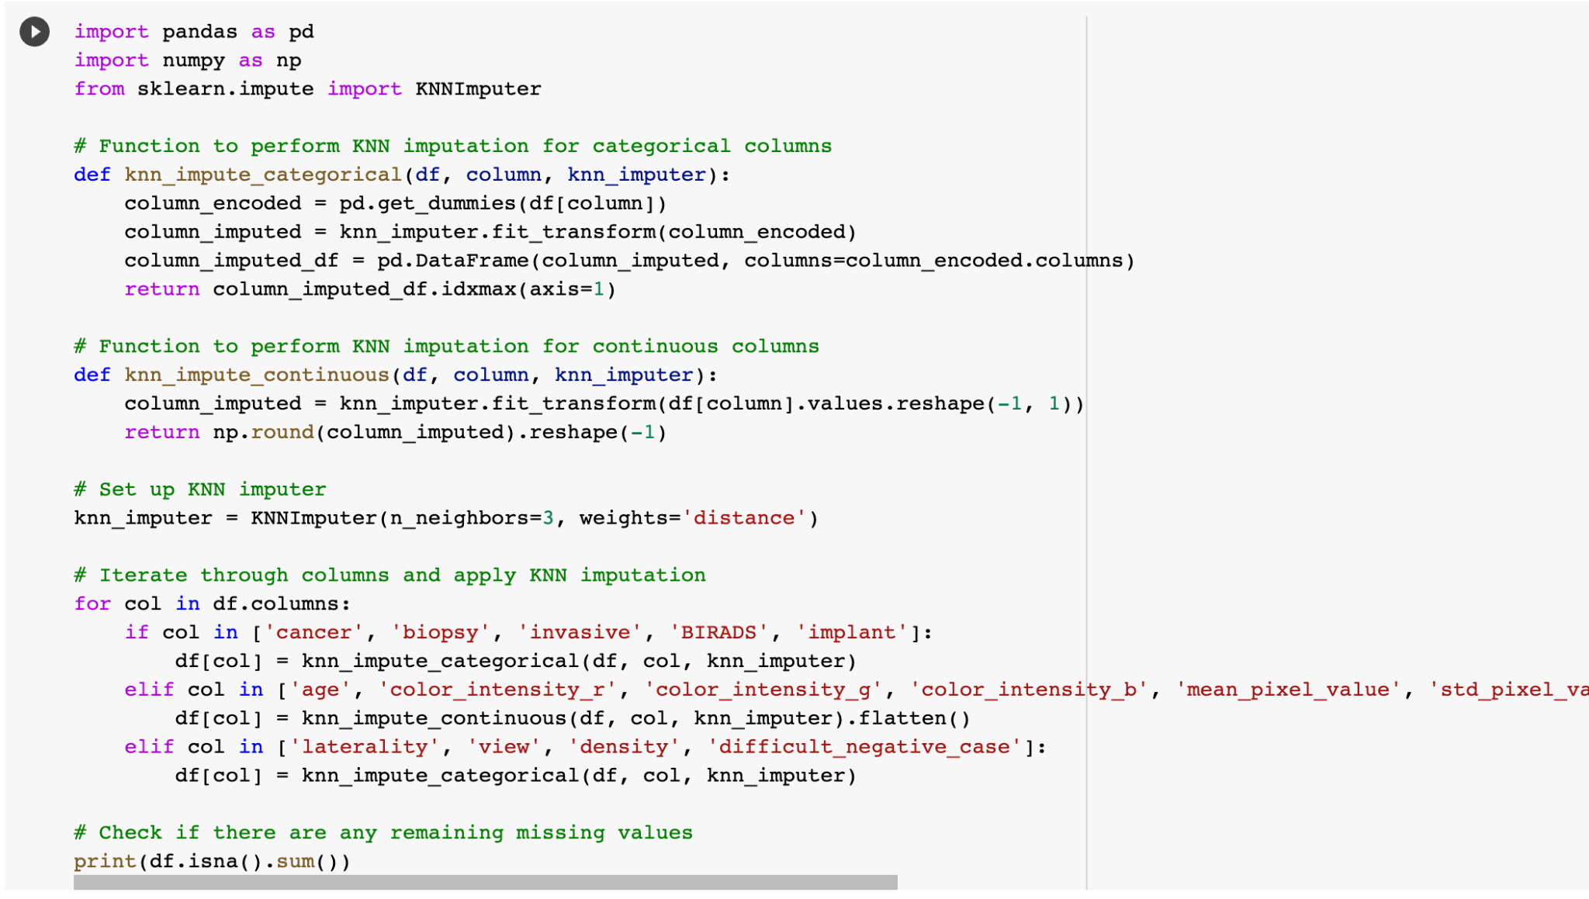

Slide 52
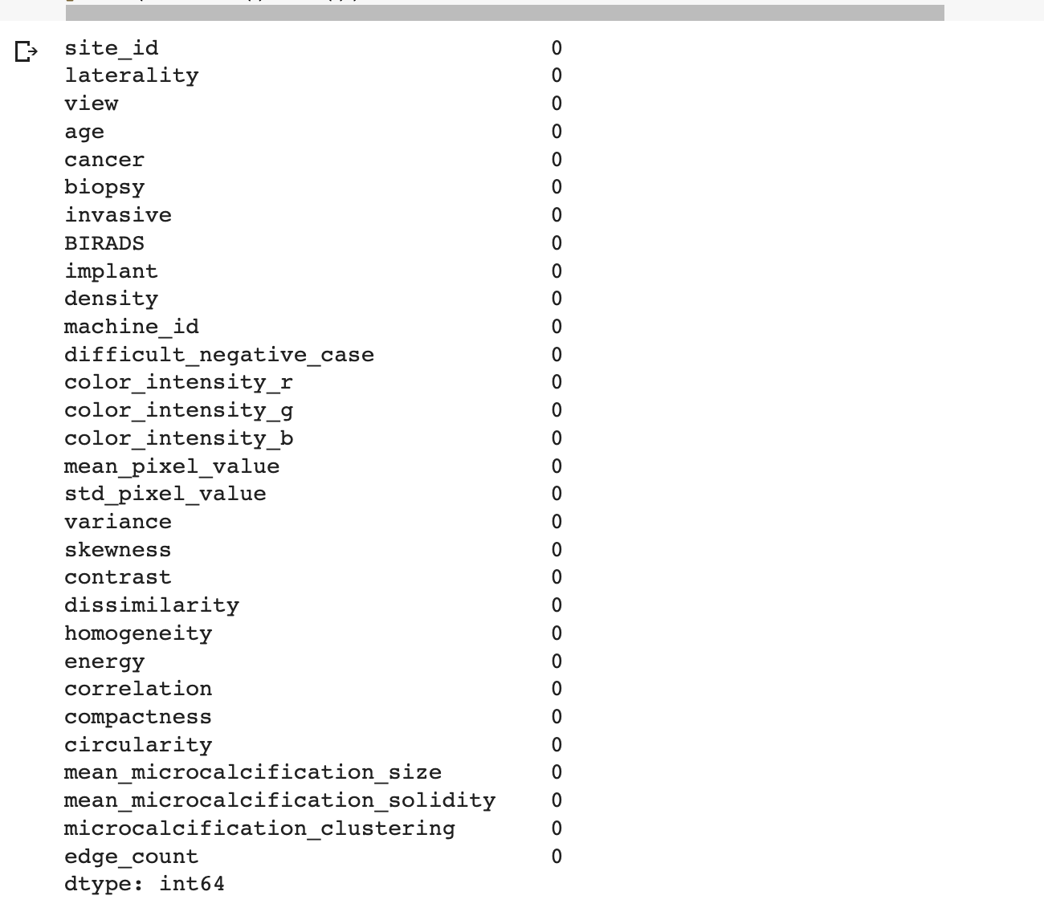

Slide 53
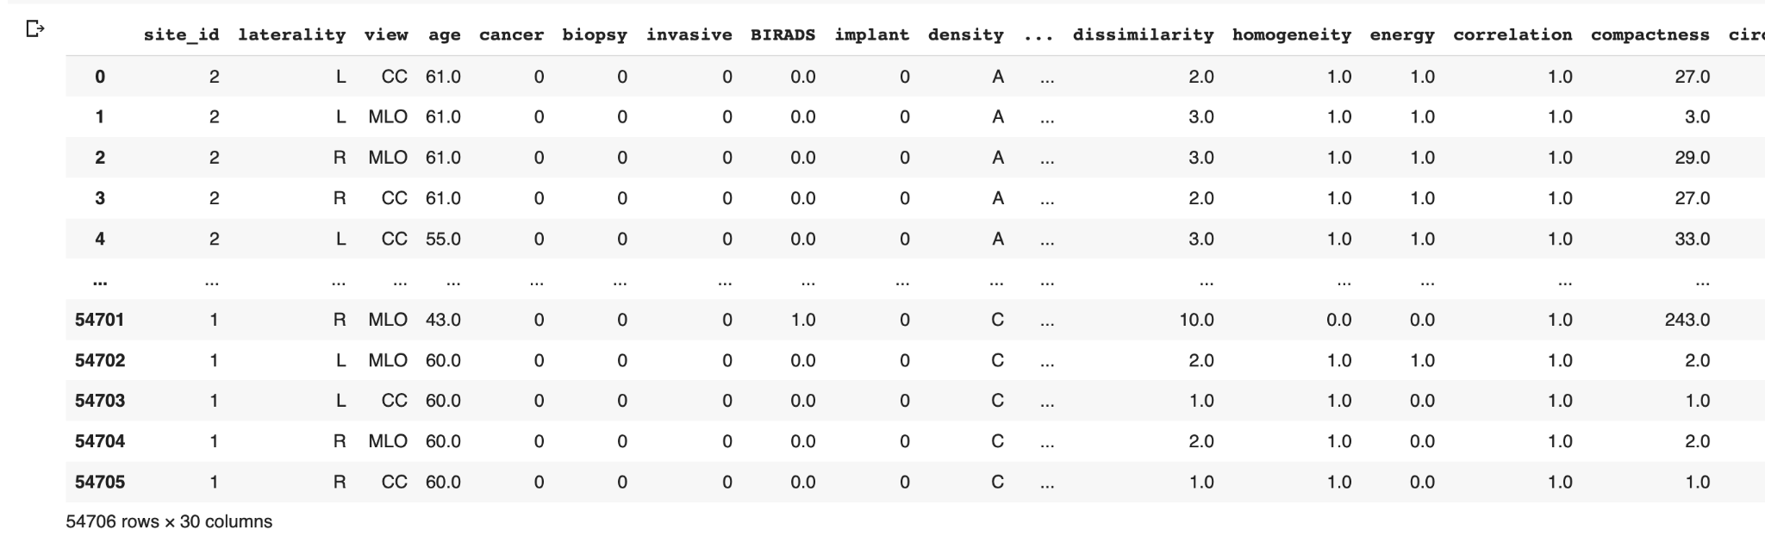
Pre - Processed Data

Slide 54
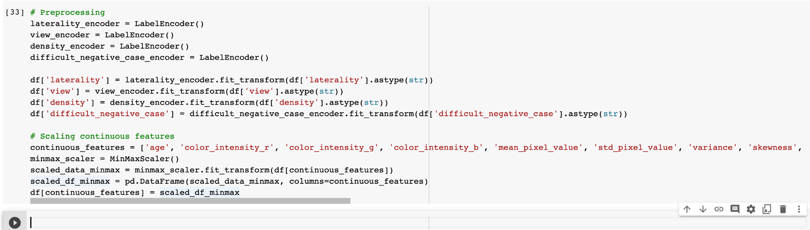
Pre - Processed Data

Slide 55
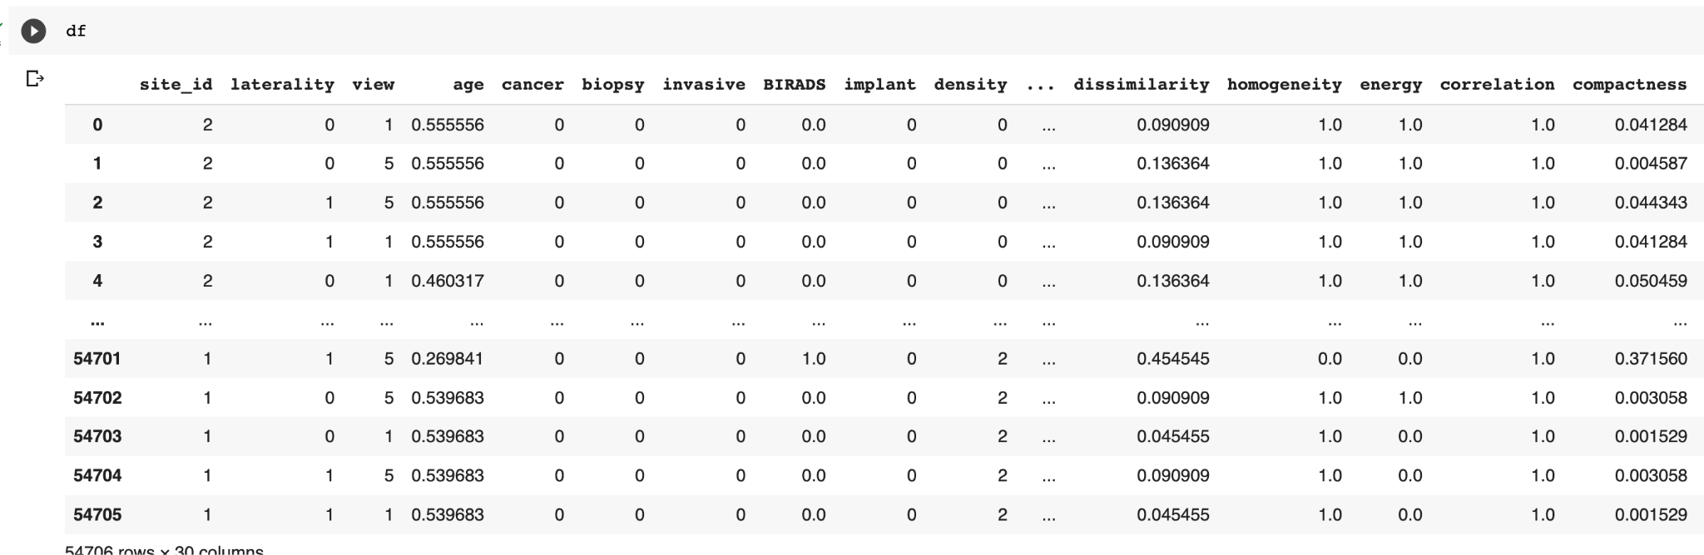
Post- Processed Data

Slide 56
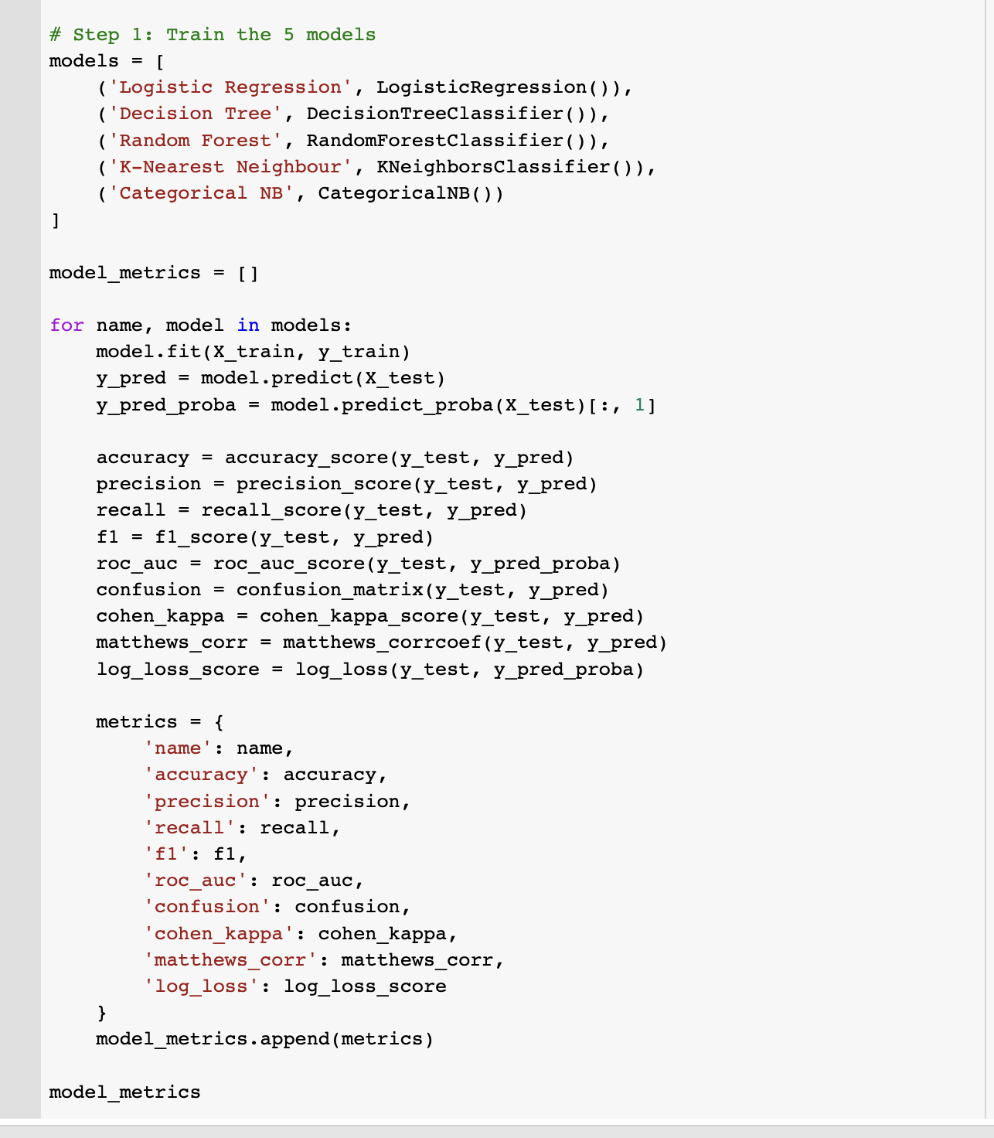

Slide 57
[1] 'accuracy': (TP + TN) / (TP + TN + FP + FN),
'accuracy': Proportion of correct predictions among total predictions; high accuracy indicates better classifier performance.
[2] 'precision': TP / (TP + FP)
'precision': Ratio of true positive predictions to total positive predictions; high precision indicates fewer false positives.
'recall': TP / (TP + FN)
'recall': Ratio of true positives to the sum of true positives and false negatives; high recall indicates fewer false negatives.
[3] 'f1': 2 * (precision * recall) / (precision + recall),
'f1': Harmonic mean of precision and recall; higher F1 score indicates better balance between precision and recall.
[4] 'roc_auc': Area under the receiver operating characteristic (ROC) curve; higher AUC indicates better classifier performance across various thresholds.
[5] 'confusion': Matrix of [ [TP, FP], [FN, TN] ],
'confusion': Matrix representing the counts of true positive (TP), true negative (TN), false positive (FP), and false negative (FN) predictions.
[6] 'cohen_kappa': (observed_accuracy - chance_accuracy) / (1 - chance_accuracy),
'cohen_kappa': Agreement between predicted and actual labels, adjusted for chance; higher kappa values indicate better agreement.
[7] 'matthews_corr': (TPTN - FPFN) / sqrt((TP+FP)(TP+FN)(TN+FP)*(TN+FN)),
'matthews_corr': Correlation coefficient between observed and predicted binary classifications; higher values indicate better classifier performance.
[8] 'log_loss': -1 * (y * log(y_pred) + (1 - y) * log(1 - y_pred)) (averaged over samples)
'log_loss': Measure of the difference between predicted probabilities and true labels; lower values indicate better classifier performance.

Slide 58
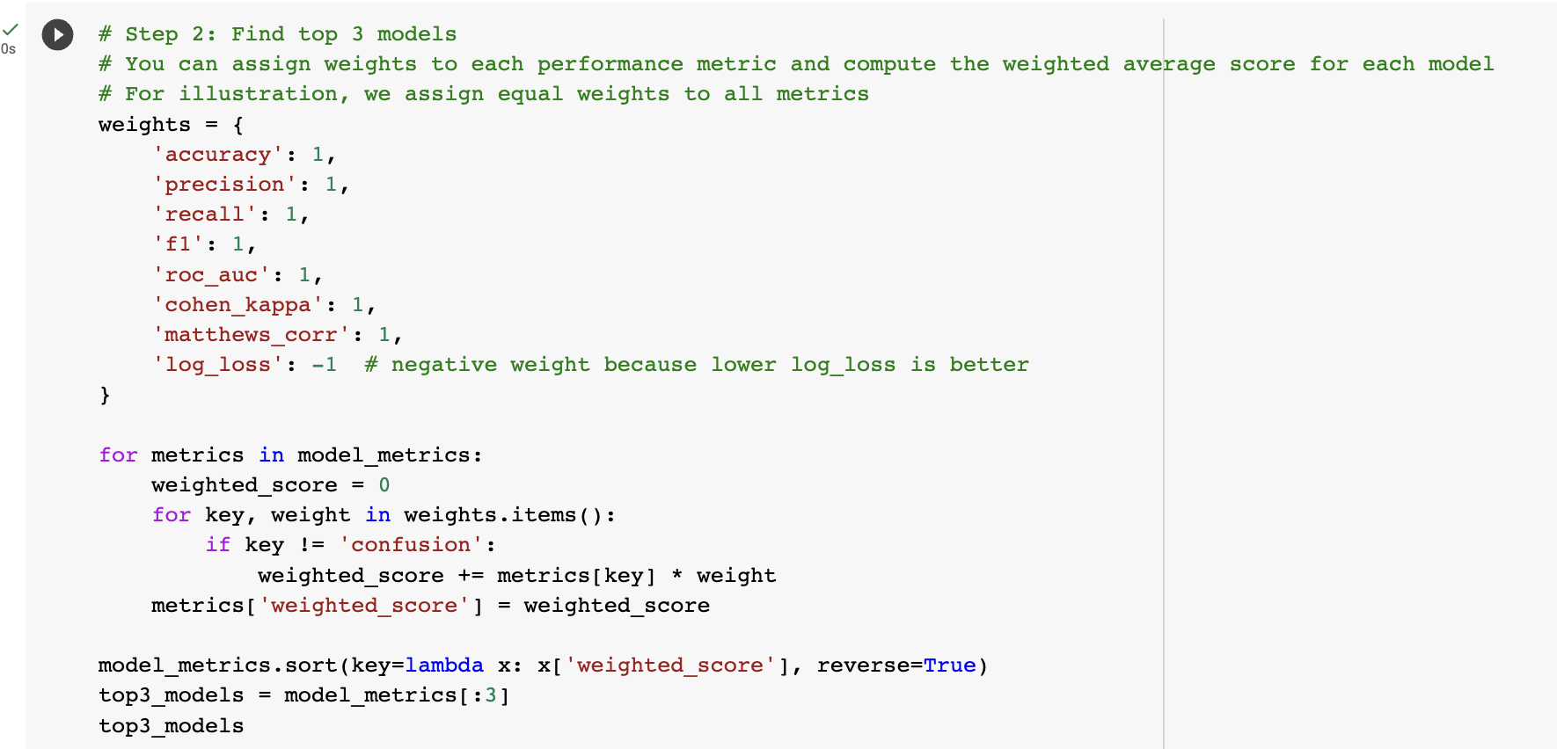

Slide 59
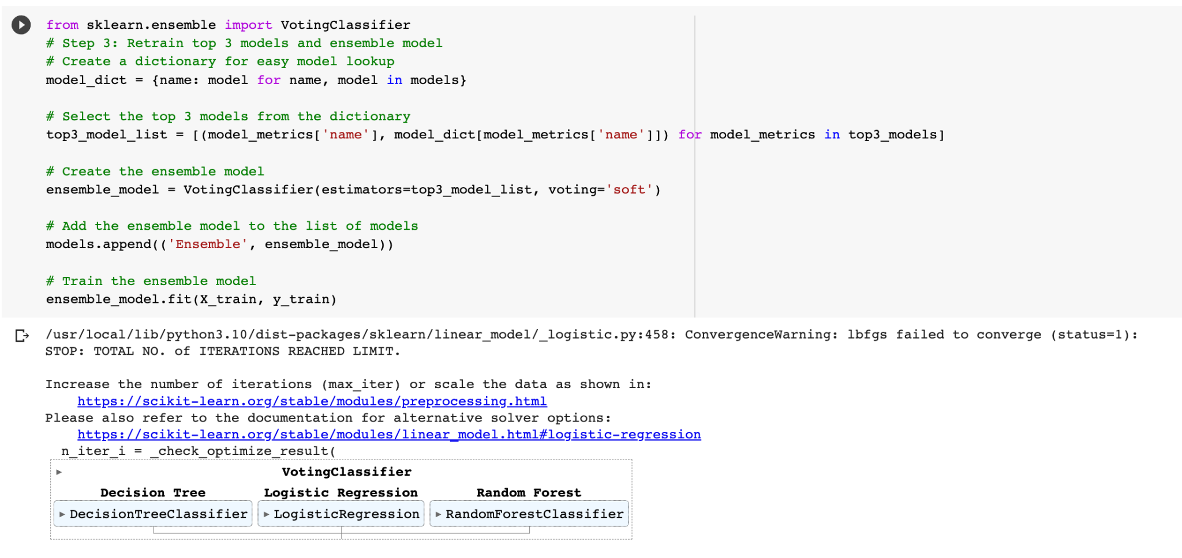

Slide 60
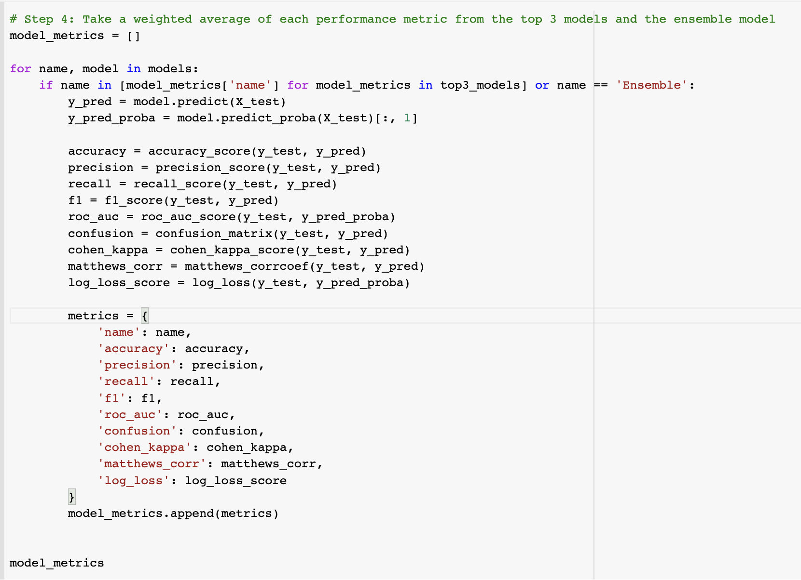

Slide 61
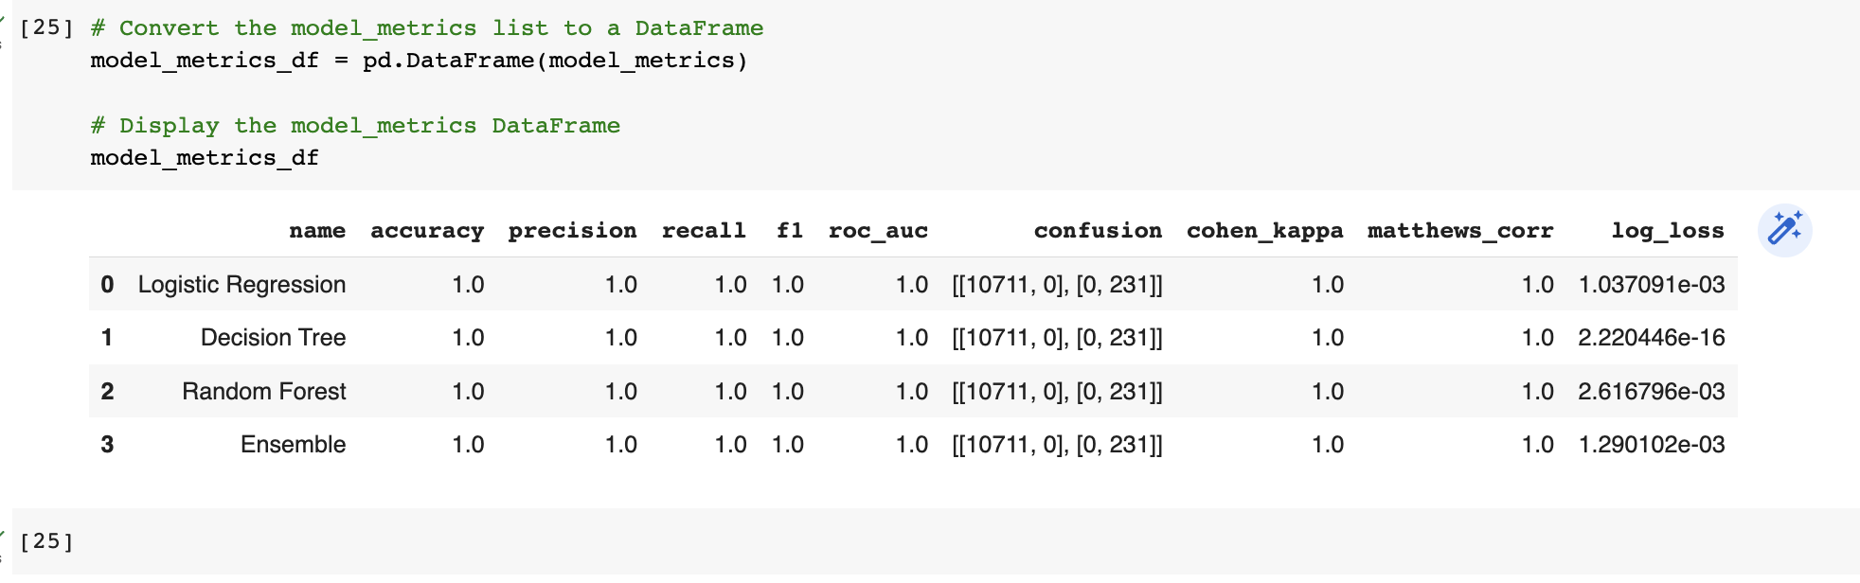

Slide 62
Shakshi

Slide 63
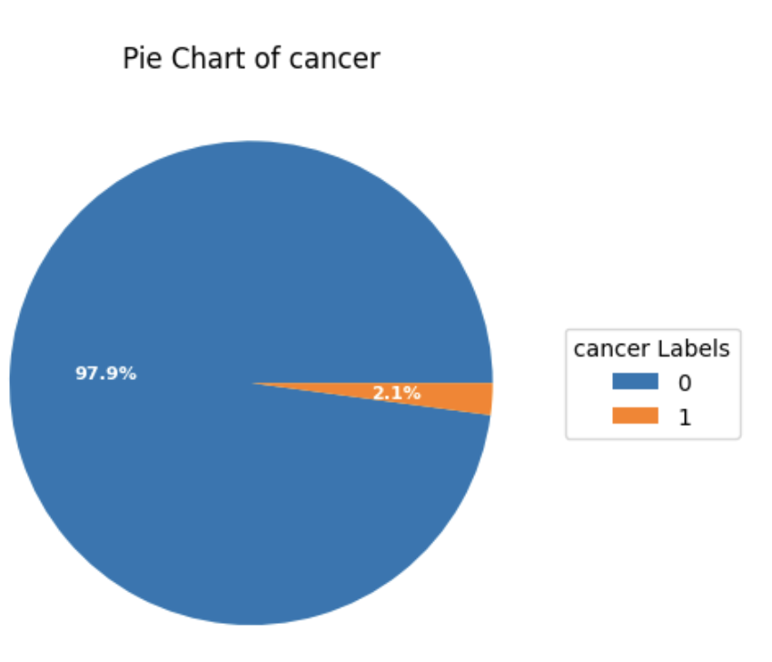

Slide 64


Slide 65


Slide 66


Slide 67

Vinit
Notes:
Hello everyone,
Today, I would like to talk about the issue of dataset imbalance and the steps we took to resolve it in our recent project. As you may already know, dataset imbalance is a common problem in machine learning, where one or more classes in the dataset have significantly fewer instances than the others.
In our project, we encountered a similar issue, where the minority class had only a few instances. We initially tried using stratify and equal number of classes, but unfortunately, we did not see any significant improvement in the model's performance.
To address this issue, we used a technique called "undersampling," which involves removing instances from the majority class to balance the dataset. We used the Random Under Sampling (RUS) technique, which randomly removes instances from the majority class until the classes are balanced.
This technique helped us balance the classes in our dataset and improved our model's performance significantly. We also used SMOTE to oversample the minority class, but in combination with RUS, it showed a further improvement in model performance.
Moving on, we also used the VotingClassifier from the scikit-learn library to improve our model's accuracy. The VotingClassifier is an ensemble method that combines the predictions from multiple classifiers and predicts the class with the most votes.
In our case, we used three different classifiers - Random Forest, Support Vector Machine, and Gradient Boosting - and combined their predictions using the VotingClassifier. This helped us achieve a higher accuracy than using any of the classifiers individually.
Lastly, we also developed a user interface (UI) app for our project, which made it easy for users to input data and get predictions from our model. The UI was developed using Streamlit, a popular Python library for building interactive web applications.
In conclusion, we were able to overcome the issue of dataset imbalance by using a combination of undersampling and oversampling techniques and improve our model's accuracy using the VotingClassifier. Additionally, we developed a user-friendly UI app using Streamlit, which made it easy for users to interact with our model.
Thank you for listening.

Slide 70


Slide 71


Slide 72


Slide 73


Slide 74


Slide 75


Slide 76

FrontEnd

Slide 77

FrontEnd

Slide 78
Shakshi

Slide 79
Creativity : Data Extraction from Images

Slide 80
Creativity and Innovation:
Extracted Features from 55k images Highlight the extraction of key features from a dataset of 55,000 mammogram images.
Explain the significance of these features in identifying and diagnosing breast cancer.
Built an Application

Slide 81
Contribution to society
Early Detection and Improved Outcomes to help Healthcare Professionals.
Healthcare Resource Optimization
Better detection leads to improved treatment outcomes and patient survival rates.
Public Health and Policy Planning
Potential to significantly impact society by improving early detection, personalized treatment, and overall patient outcomes.

Slide 82
References
https://www.wikipedia.org/
https://chat.openai.com/chat
https://www.youtube.com/
https://www.google.com/

Slide 83

Meghna
Shakshi
Vinit
Kapil

